Slide 1

Problem Statement ID: UHCK_AI004
Problem Statement Title:
Smart Allocation of Tipper-Shovel in Open-pit Mines
Team ID: UHCK_NT006
Team Name: TechBlazers

Slide 2

Abstract
Open-pit mining operations rely on trucks and shovels for mineral extraction, making their efficient allocation critical for productivity and profitability. We focus on optimizing this allocation to maximize production while minimizing operational costs. We explore two methods: first, utilizing trucks at full capacity, and second, using trucks below full capacity to increase travel speed. The main challenge lies in working with a fixed fleet size, but we also investigate reverse thinking to identify an optimum fleet size for enhanced production. For instance, replacing a 56t capacity truck with a 65t one, despite slightly higher fuel consumption, can lead to a substantial production increase.

Slide 3
Methodology
We are approaching the problem with two methods:
Method 1: Utilizing Trucks at Full Capacity :
Data Collection and Specifications: We collect detailed specifications of truck capacities, shovel production speeds, and distances between shovels and unloading points.
Initial Truck Allocation: At the beginning of the shift (t=0), we allocate maximum capacity trucks to the most efficient shovels to keep them consistently engaged.
Shovel Queue Arrangement: Let's consider three shovels labeled as s1, s2, and s3. After accounting for already queued trucks and the time each shovel takes to fill them, we find that s1 will be free after 4 units of time, s2 after 5 units of time, and s3 after 3 units of time. Consequently, the arranged stack, in increasing order of their idle time, will be [[s3], [s1], [s2]].
Shovel Assignment on Truck Arrival: Upon a truck's arrival at an unloading point, we assign the returning shovel based on a priority parameter considering time to reach the shovel, waiting period after arrival, and expected engagement time. Obviously better efficient shovels will be preferred more when it will be tie for other factors.
Unloading Point Allocation: When a truck is at a shovel point, we determine the unloading point based on factors like distance, the number of trucks already assigned, and their capacities. We prioritize early availability of higher-capacity trucks for efficient shovel usage. Here we are focusing to have better options at unloading point like we want to have 96t(tonne) truck free earlier than 65t truck. So, that it can be utilized at efficient shovel point.

Slide 4
Advantages of Method1:
Real-time delays are accounted for, ensuring a practical approach.
In case of unusable trucks, we can effectively reallocate resources.
Highly efficient shovels are given significant priority, leading to improved overall productivity.
Idle time for higher-order shovels is minimized, optimizing resource utilization.

Slide 5
Method 2: Utilizing Trucks at its fraction of Capacity
Match Factor: The match factor denotes the optimal ratio of trucks to shovels in open-pit mining, where a value close to one signifies an efficient allocation. A match factor of 1 ensures shovels are continuously operational without any idle time.
Fixed Fleet Size Constraint: Despite facing a fixed fleet size, we address this challenge by employing trucks at a fraction of their capacity, enhancing their travel speed.
Efficiency vs. Load Capacity: Transporting a reduced load in each truck improves their speed, though at the cost of higher fuel consumption. However, this strategy leads to an overall increased match factor, consequently elevating production efficiency.
Example:
Consider a 10-tonne truck, now filled with only 7 tonnes, resulting in a reduced loading time from 5 to 3 minutes. Additionally, the time taken to return to the shovel point after unloading is 2 minutes. Thus, the overall time decreases from 7 minutes to 5 minutes, providing a 2-minute advantage.
Strategic Trade-Off: This 2-minute advantage is strategically leveraged, acknowledging the additional fuel consumption as a trade-off. The objective is to substantially increase production, compensating for the extra fuel costs, and ultimately yielding greater profits.

Slide 6
Advantages of Method2:
Faster travel times due to increased truck speed.
Overall enhanced productivity and output.
Greater profitability resulting from improved match factor.
Near elimination of idle time, maximizing operational efficiency.

Slide 7
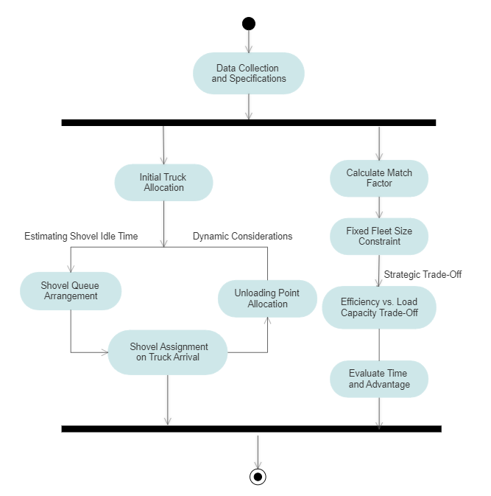
Flowchart

